Slide 1


CAPSTONE PROJECT
Life expectancy analysis and visualization using power BI
Presented By
Student Name: Prasanth m
College Name: Vellore institute of technology, vellore
Department: mtech - cse
Email ID: prasanthtech1905@gmail.com

Slide 2
OUTLINE:
Problem Statement
Proposed System/Solution
System Development Approach
Algorithm & Deployment
Result
Conclusion
Future Scope
References

Slide 3
Problem Statement:
Life expectancy is one of the most important indicators of a country’s overall health and development. However, raw life expectancy data is often large, complex, and difficult to interpret using traditional analysis methods.
Without proper visualization, it becomes challenging to:
Compare life expectancy across countries and regions
Analyze trends over years
Understand the impact of factors such as GDP, healthcare, and population
There is a need for an interactive and visual analytics system that can transform life expectancy data into meaningful insights.

Slide 4
Proposed Solution:
The proposed system is a Power BI–based data visualization dashboard that analyzes and presents life expectancy data in an interactive and user-friendly manner.
Key Objectives:
Visualize life expectancy trends across countries and years
Enable comparison using slicers and filters
Identify patterns and insights from global health data
Support data-driven decision-making through dashboards

Slide 5
System Approach:
System Requirements
Windows Operating System
Microsoft Power BI Desktop
Life Expectancy Dataset (CSV / Excel)
Technologies Used
Power BI Desktop
Data Modeling
Power Query (ETL)
DAX (Data Analysis Expressions)
Interactive Dashboards & Visuals

Slide 6
procedure:
Data Collection & Preprocessing
Imported life expectancy dataset into Power BI
Cleaned missing and inconsistent values using Power Query
Renamed columns for clarity
Converted data types (year, numeric values)
Created relationships between tables (if applicable)

Slide 7
Dashboard design and analysis:
Visuals Used
Line charts to show life expectancy trends over years
Bar charts for country-wise comparison
Map visualization for geographic analysis
KPI cards for average life expectancy
Slicers for year and country selection
Interactivity
Dynamic filtering using slicers
Drill-down analysis
Real-time visual updates based on selection

Slide 8
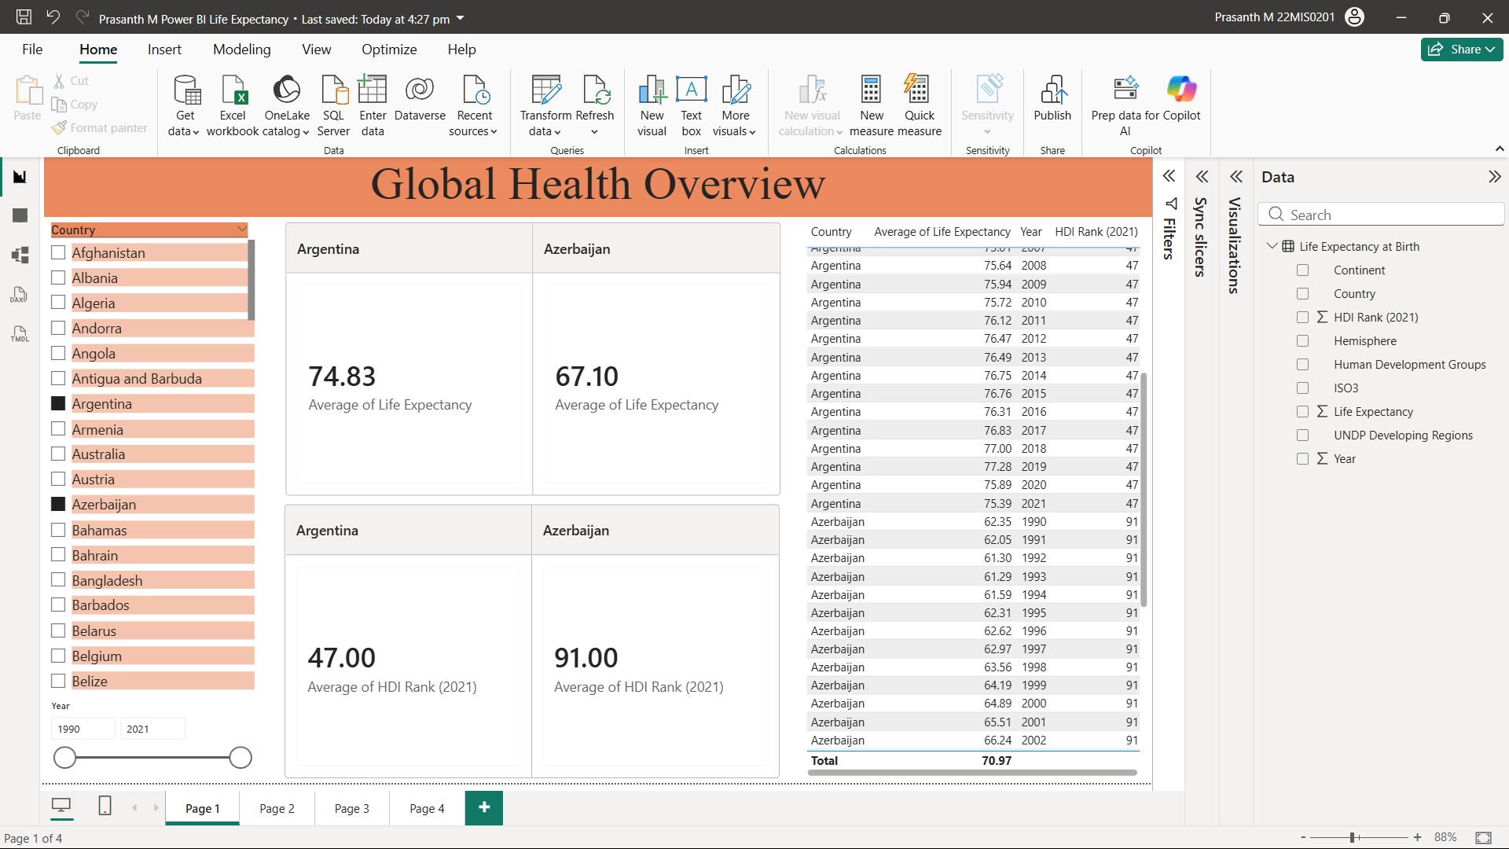
Result:

Slide 9
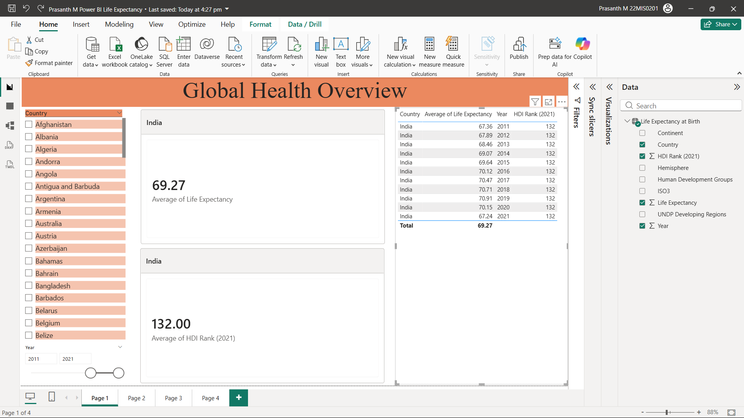
Result:

Slide 10
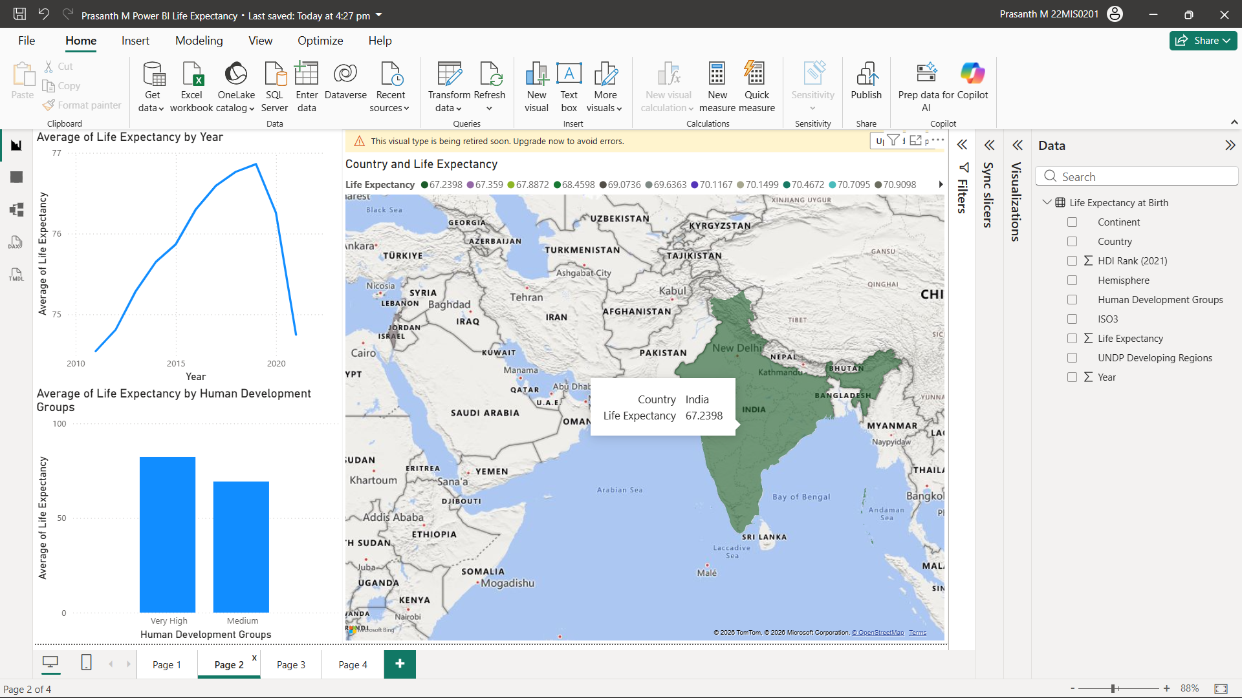
Result:

Slide 11
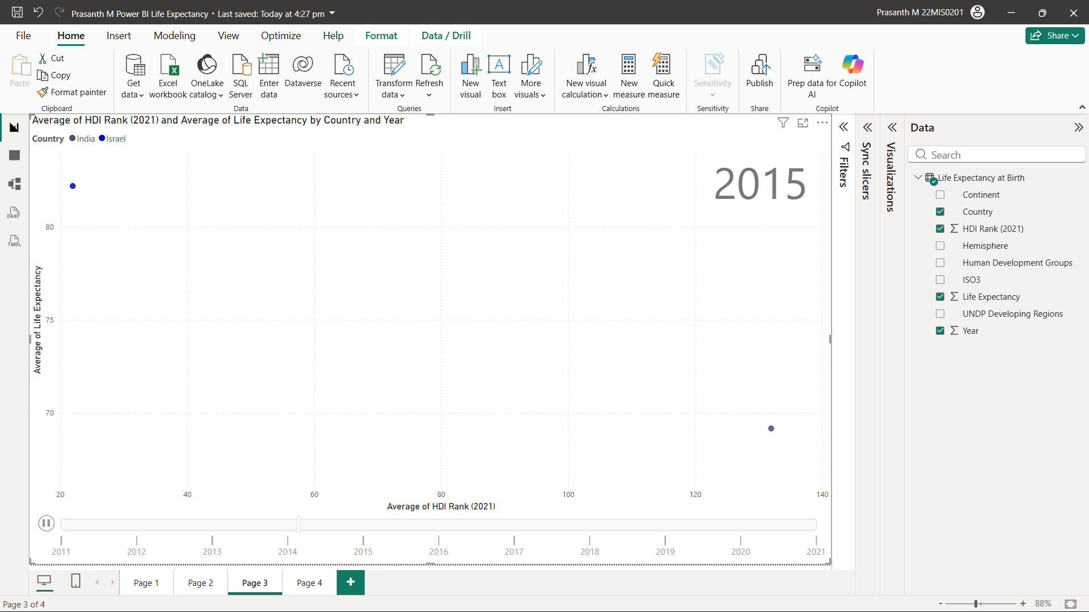
Result:

Slide 12
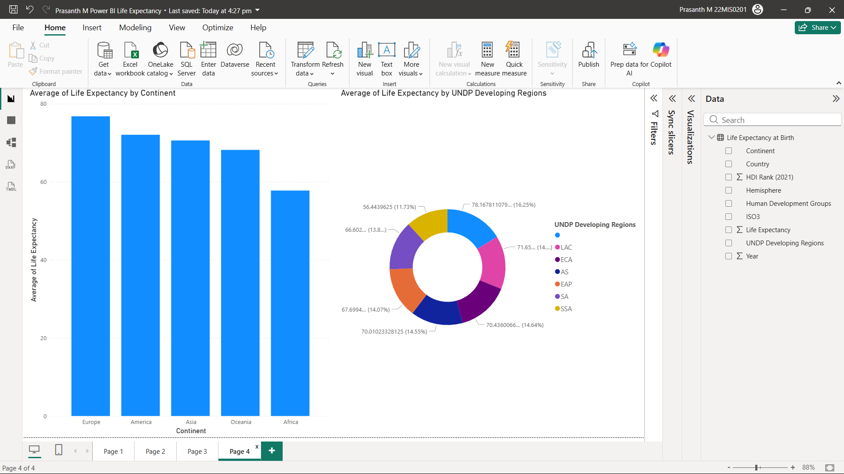
Result:

Slide 13
Conclusion:
This project demonstrates how Power BI can be effectively used for data visualization and analytical reporting.
By analyzing life expectancy data, the dashboard provides meaningful insights into global health patterns.
The project improved practical skills in:
  Data cleaning and transformation
  Dashboard design
  Interactive data analysis

Slide 14
Future scope:
Integration of additional health indicators (mortality rate, healthcare spending)
Predictive analysis using Power BI + Python/R
Real-time data integration
Deployment using Power BI Service
Advanced DAX calculations

Slide 15
References:
https://learn.microsoft.com/en-us/power-bi/
https://powerbi.microsoft.com/
https://www.who.int/data
https://www.kaggle.com/datasets
https://learn.microsoft.com/en-us/power-query/
GitHub Link:

Slide 16
Thank You

